Slide 1
Business Data Communications
Fourteenth Edition
Jerry FitzGerald, Alan Dennis, and Alexandra Durcikova
Chapter 9
Wide Area Networks

Slide 2
Learning Objectives
Develop and understanding of dedicated-circuit services/architectures
Develop and understanding of packet-switched services/architectures
Develop and understanding of Internet-based VPN services/architectures
Develop and understanding of best practice recommendations for WAN design.
Be familiar with improving WAN performance.

Slide 3
9.1 Introduction
Wide area networks (WANs) typically run long distances, connecting different offices in different cities or countries
Most organizations rent or lease circuits from common carriers.
As a customer, you do not lease physical cables; you lease circuits that provide certain transmission characteristics.
A common carrier that provides local telephone services is commonly called a local exchange carrier (LEC).
A common carrier that provides long-distance services is commonly called an interexchange carrier (IXC).

Slide 4
Introduction Continued
The market for WAN services has rapidly changed over the past few years for two reasons:
The underlying technologies have changed
More companies are using cloud-based services rather than deploying applications on servers on their own internal networks
Will discuss three types of WAN services
Dedicated-circuit services
Packet-switched services
Using the public Internet to provide a Virtual Private Network

Slide 5
9.2 Dedicated-Circuit Networks
With a dedicated-circuit network, the user leases circuits from the common carrier for their exclusive use 24 hours per day, 7 days per week
Sometimes called private line services.
It is like having your own private network, but it is managed by the common carrier.
Some experts believe that they will slowly disappear over the next 10 years, as packet-switched services become more popular.

Slide 6
Basic Architecture
With a dedicated-circuit network, you lease circuits from common carriers
All connections are point to point.
The user installs the equipment needed to connect computers and devices to the circuit
This equipment may include multiplexers or a channel service unit (CSU) and/or a data service unit (DSU).
Dedicated circuits are billed at a flat fee per month

Slide 7
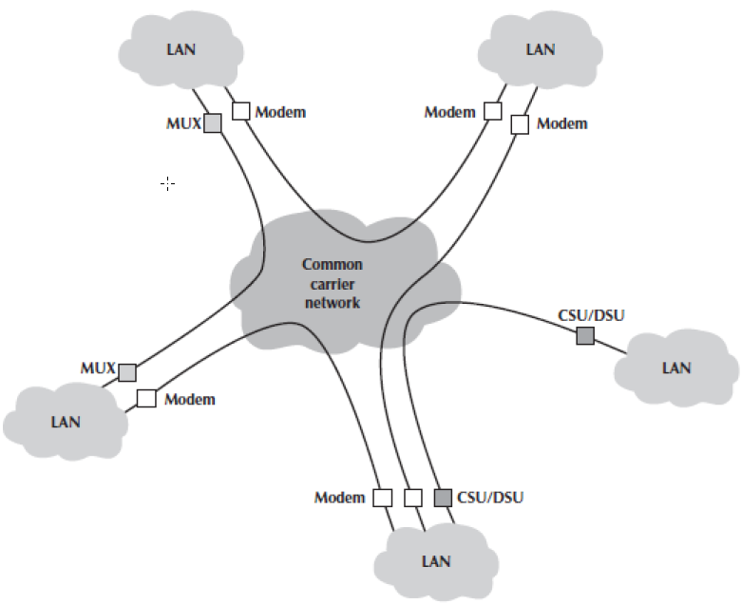
Three Basic Architectures
Ring
Star
Mesh

Slide 8
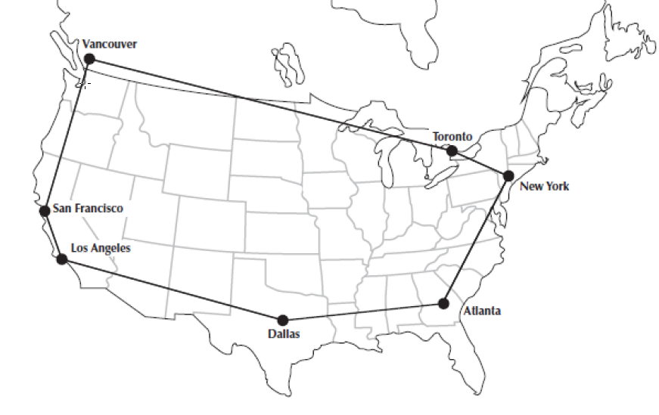
Ring Architecture
A ring architecture connects all computers in a closed loop with each computer linked to the next
The circuits are full-duplex or half-duplex.
One disadvantage of the ring topology is that messages can take a long time.
The failure of any one circuit or computer means that the network can continue to function.

Slide 9
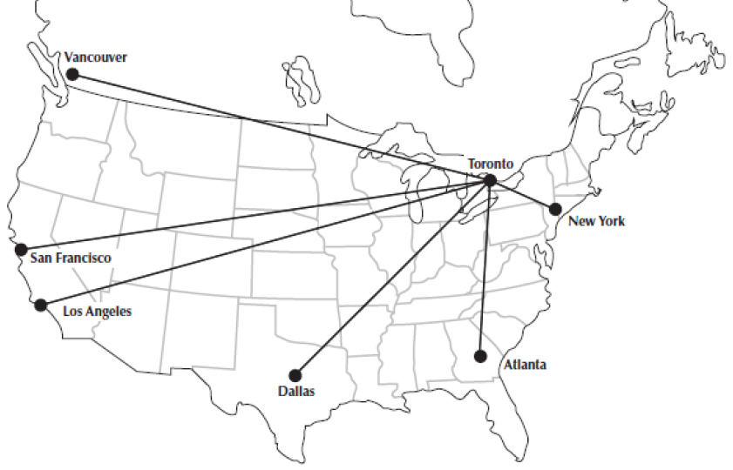
Star Architecture
A star architecture connects all computers to one central computer.
It is easy to manage
It is the most susceptible to traffic problems.
The central computer must have sufficient capacity to handle traffic peaks.
The failure of any one circuit affects only the one circuit
Central computer failure causes the network to fail

Slide 10
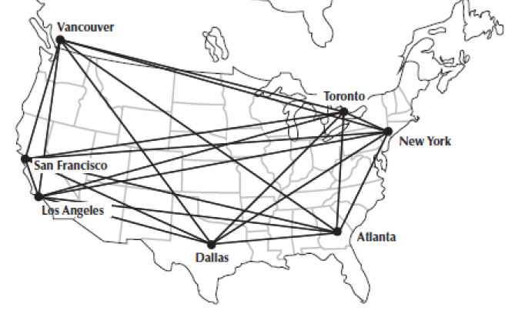
Full Mesh Architecture
In a full-mesh architecture, every computer is connected to every other computer.
It is seldom used because of the extremely high cost.

Slide 11
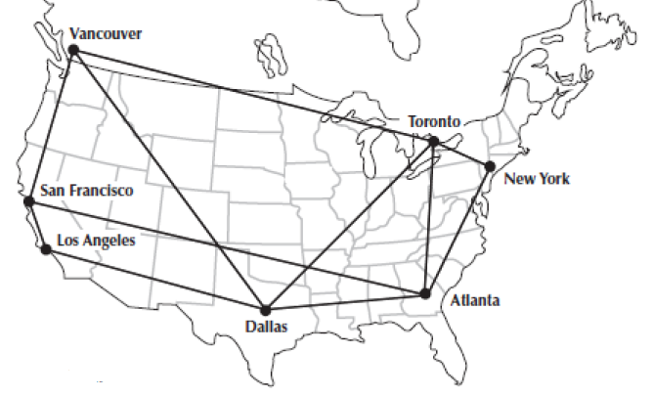
Partial Mesh Architecture
Partial-mesh architecture is where many, but not all, computers are connected
Usually called just mesh architecture
Much more common
The effects of the loss of circuits depend on the circuits available in the network
Mesh networks combine the performance benefits of both ring networks and star networks
The drawback is the use of decentralized routing

Slide 12
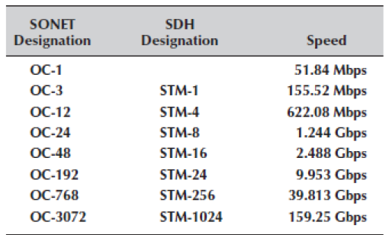
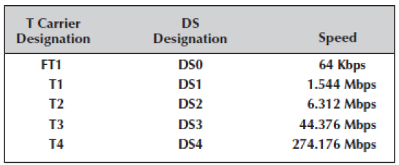
T-Carrier and SONET Services

Slide 13
9.3 Packet-Switched Networks
Packet-switched networks operate more like Ethernet and IP networks used in the LANs and BNs than like dedicated-circuit networks
Packet-switched services enable multiple connections to exist simultaneously between computers over the same physical circuit, just like LANs and BNs.

Slide 14
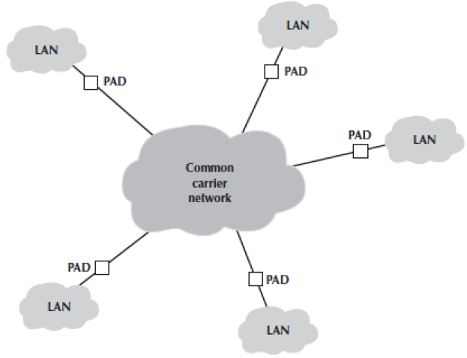
Basic Architecture
With packet-switched services, the user buys a connection into the common carrier cloud.
The user pays a fixed fee for the connection into the network and is charged for the number of packets transmitted.
The user’s connection into the network is a packet assembly/disassembly device (PAD).

Slide 15
Basic Architecture Continued
One of the key advantages of packet-switched services is that different locations can have different connection speeds.
Packet-switched networks enable packets from separate messages with different destinations to be interleaved for transmission.

Slide 16
Basic Architecture Continued
The connections between the different locations in the packet network are called permanent virtual circuits (PVCs).
Some common carriers also permit the use of switched virtual circuits (SVCs).
Organizations often lease a dedicated circuit their offices to the packet-switched network point of presence (POP)

Slide 17
Three Types of Packet-Switched Services
Frame relay
MPLS
Ethernet

Slide 18
Frame Relay Services
Frame relay is one of the oldest used packet services.
Most companies are no longer installing it.
Frame relay uses T carrier and SONET as its circuits
It is an unreliable packet service because it does not perform error control
Some common carriers permit users to specify two different types of data rates
The committed information rate (CIR) is the data rate the PVC guarantees to transmit
The maximum allowable rate (MAR) is the maximum rate that the network will attempt to provide

Slide 19
MPLS Services
Multiprotocol label switching (MPLS) is a layer 2 service because it is commonly used with IP for routing at layer 3.
With MPLS, the PAD at the sending site takes the message, strips off the Ethernet frame, and uses the IP address in the IP packet to route the packet through the carrier’s packet-switched network to its final destination.

Slide 20
Ethernet Services
Most organizations today use Ethernet and IP in the LAN and BN environments
WAN packet network services use different layer 2 protocols
Any LAN or BN traffic, therefore, must be translated or encapsulated into a new protocol and destination addresses generated for the new protocol.
Frame relay and MPLS services use the traditional telephone company WAN networks.
Ethernet services bypass this network.
Companies offering Ethernet services have laid their own gigabit Ethernet fiber-optic networks in large cities.
Ethernet services are much more flexible than the old WAN technologies.

Slide 21
9.4 Virtual Private Networks
A virtual private network (VPN) provides the equivalent of a private packet-switched network over the public Internet
It involves establishing a series of PVCs that run over the Internet so that the network acts like a set of dedicated circuits even though the data flows over the Internet.
VPN services are very cheap, but only as reliable as the Internet.

Slide 22
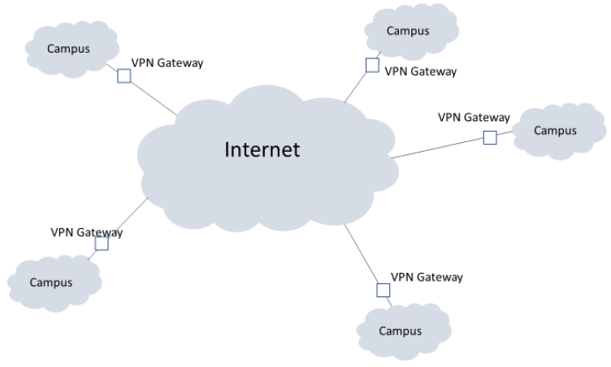
Basic Architecture
You first lease an Internet connection for each location
You pay the common carrier for the circuit and the ISP for Internet access
Then you connect a VPN gateway to each Internet access circuit.

Slide 23
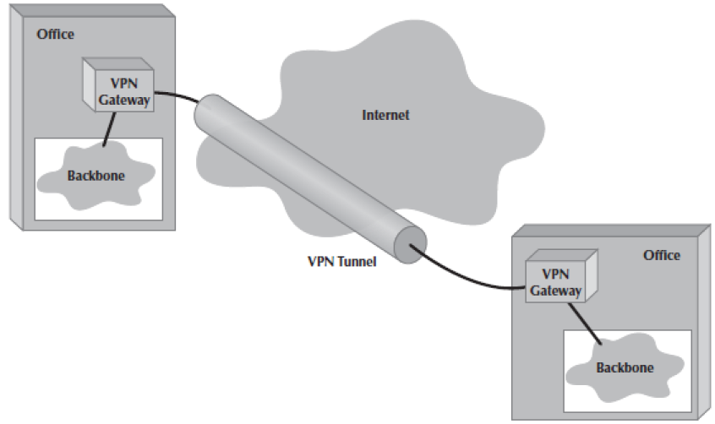
VPN Tunnels
The VPN gateways enable you to create PVCs through the Internet
These are called tunnels
The VPN is transparent to the users.
It is also transparent to the ISP and the Internet as a whole.
VPN software is commonly used on home computers.

Slide 24
More on VPNs
VPNs operate either at layer 2 or layer 3
A layer 2 VPN uses the layer 2 packet to select the VPN tunnel and encapsulates the entire packet.
A layer 3 VPN uses the layer 3 packet to select the VPN tunnel and encapsulates the entire packet, starting with the layer 3 packet.
The primary advantages of VPNs are low cost and flexibility
There are two important disadvantages:
Traffic on the Internet is unpredictable
Because the data travel on the Internet, security is always a concern; although, move VPNs use encryption.

Slide 25
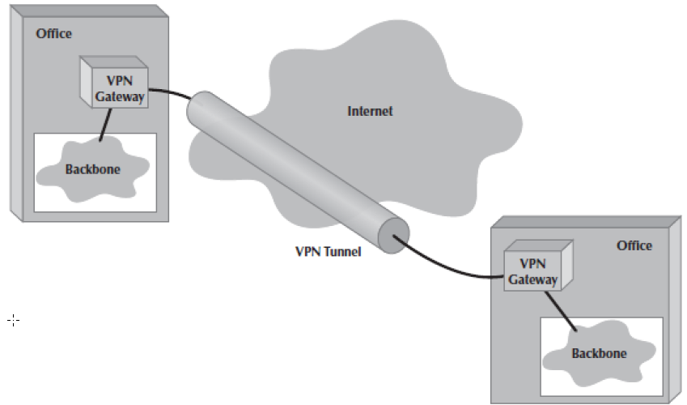
Three VPN Types
An intranet VPN provides virtual circuits between organization offices over the Internet (figure at right)
An extranet VPN is the same as an intranet VPN, except that the VPN connects several different organizations
An access VPN enables employees to access an organization’s networks from a remote location.

Slide 26
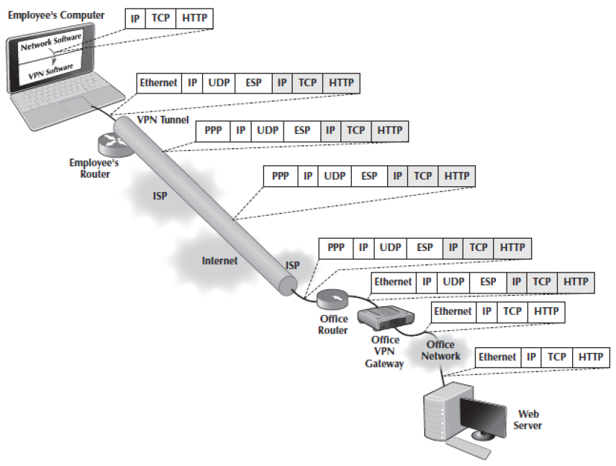
How VPNs Work
VPNs provide security by encapsulating packets in a separate, secure packet that is encrypted.
Layer 2 and layer 3 VPNs work very similarly.

Slide 27
How VPNs Work Continued
An employee starts the VPN software on his or her computer and uses it to log into the VPN gateway at the office
The VPN software creates a new “interface” on the employee’s computer
The VPN gateway assigns an IP address to the VPN interface on the employee’s computer

Slide 28
How VPNs Work Continued
The employee’s computer now thinks it has two connections to the Internet
The VPN software makes the VPN interface the default interface
The VPN software receives the IP packet, encrypts it, and encapsulates it with an Encapsulating Security Payload (ESP) packet using IPSec encryption.

Slide 29
How VPNs Work Continued
The VPN software passes the ESP packet to the employee’s computer normal Internet interface for transmission
It then passes the ESP packet to the IP software
It passes the resulting IP packet to the Ethernet software, which adds an Ethernet frame and transmits it to the employee’s router

Slide 30
How VPNs Work Continued
The router prepares and sends the packet
The packet travels from the Internet to the ISP that connects the office to the Internet and arrives at the office’s router
The process is reversed at the receiving location

Slide 31
9.5 The Best Practice WAN Design
Developing best practice recommendations for WAN design is more difficult than for LANs and backbone networks.
The network designer is buying services from different companies rather than buying products.
The environment is now rapidly changing with the introduction of Ethernet and Internet VPN services and changing organizational needs as more organizations use cloud-based services.

Slide 32
Software Defined WAN
The increased complexity in WANs means that many organizations are implementing a Software Defined WAN (SDWAN)
A SDWAN uses software to control and manage the routers used in the WAN
An SDWAN provides four benefits:
It provides centralized management
It reduces costs by balancing network traffic over circuits that have different costs and capacities
It provides more visibility over network traffic so network managers can see end-to-end traffic flows
SDWANs provide good security.

Slide 33
Architecture of an SDWAN
The top level is the Management Plane
Some vendors call this the Orchestration Plane
This is the software that is used to control the network
The second plane is the Control Plane
This is the software that controls the network and makes the decisions
The third plane is the Data Plane
This plane includes the routers that implement the network

Slide 34
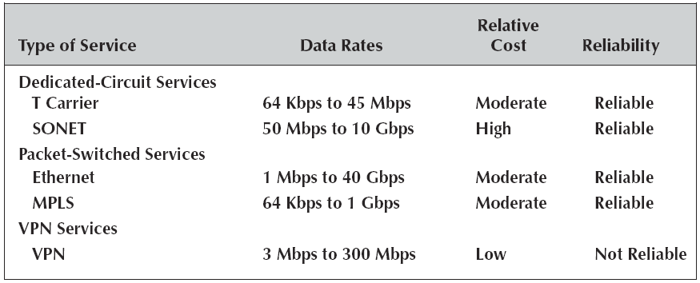
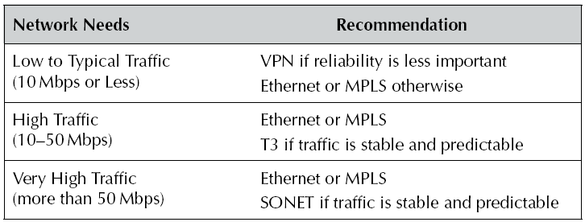
Choosing WAN Circuits

Slide 35
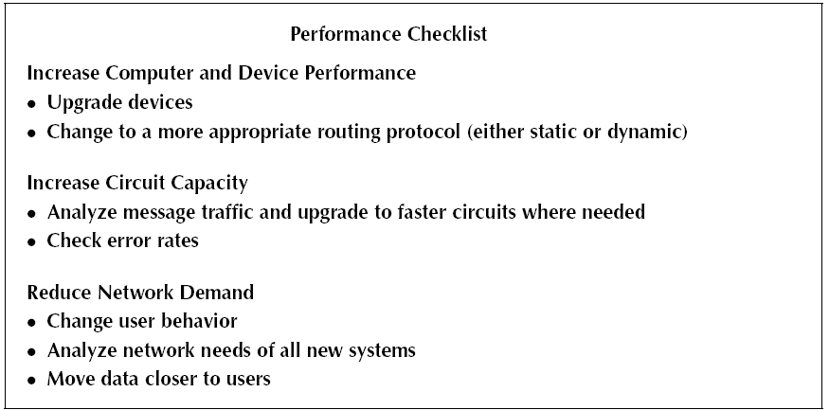
9.6 Improving WAN Performance

Slide 36
9.7 Implications for Cyber Security
A WAN is usually one of the most secure parts of the network, unless you are using a VPN over the Internet
WAN services are provided by common carriers who serve thousands of customers, so it is difficult to identify one company’s WAN traffic.
The cost of encryption is low, so most large organizations routinely use VPNs to encrypt their data on their WAN.

